Slide 1
EMG ANALYSIS and application for exoskeleton control
Anubhav Gupta
Ritika Inamke
Dinesh Patil
Guide- Prof.M.N.Annadate
Sponsored By: Nasan Medical Electronics

Slide 2
ABSTRACT
Extract EMG signals and they are applied to real world applications such as muscle rehabilitation through the employment of a motion support exoskeleton
Relation between the EMG signal and the actual torque applied by the muscle observed
Efforts have been made to design and create a cost efficient and accurate instrumentation system for EMG analysis

Slide 3
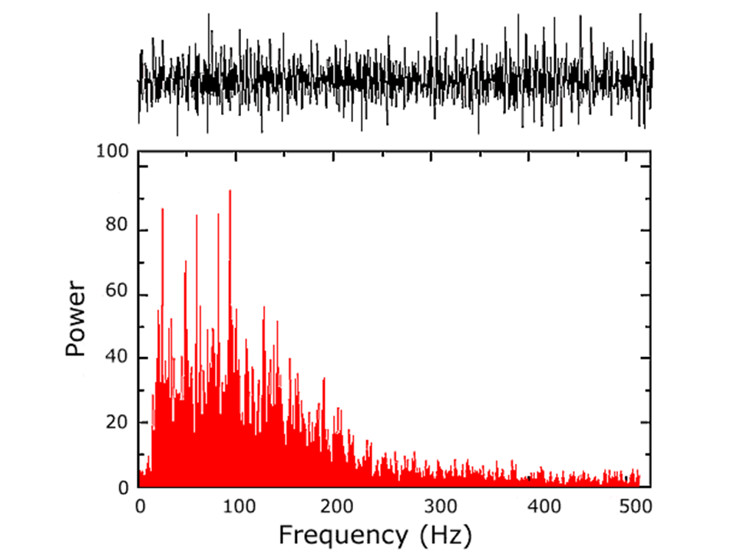
INTRODUCTION
Muscle contraction and relaxation is controlled by the central nervous system
EMG signals are the electrical muscle responses to the control signal sent by the brain to initiate the muscle activity

Slide 4
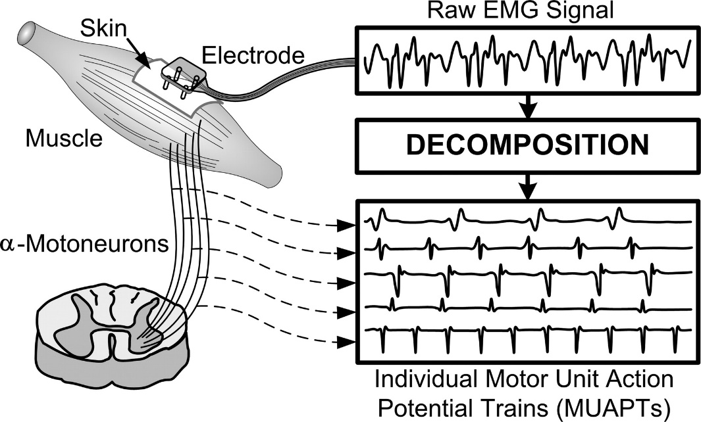
The EMG signal is a complicated signal and by its nature is purely random which means one raw recording burst cannot be precisely reproduced next time.
Electromyography (EMG) is a technique for evaluating & recording the electrical activity produced by skeletal muscles

Slide 5
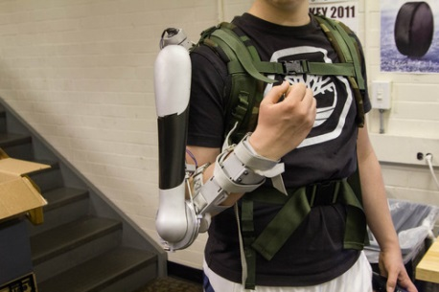
EXOSKELETON
An exoskeleton is a supporting structure on the outside of a body. The name stems from the words exterior and skeleton
The aim of developing this exoskeleton is to provide a structure in aiding the physiotherapy and muscle rehabilitation of an individual

Slide 6
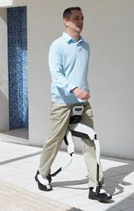
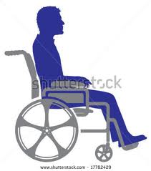
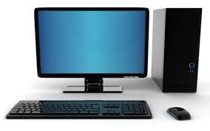

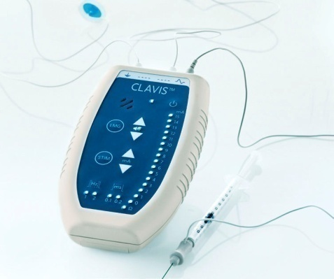
BASIC IDEA

Slide 7
PRESENT SCENARIO

Slide 8
Cyberdyne’s HAL
Robot Suit HAL (Hybrid Assisted Limb) improves a person's physical capability
Cyberdyne and Tsukuba University began hospital trials of the HAL suit in 2012 in Japan.

Slide 9
REWALK
“ReWalk” a commercial bionic walking assistance system, using powered leg attachments to enable paraplegics to stand upright and walk
Designed in Israel, the ReWalk is marketed by Argo Medical Technologies

Slide 10
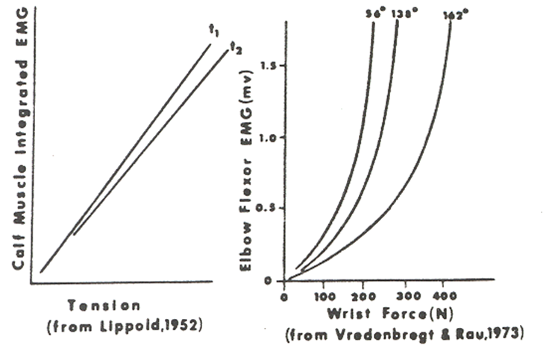
Relation between EMG signal and muscle torque
Studies of the relationship between surface EMG and force have found that there exist both linear and non-linear relationships.
The degree of linearity is dependent on the muscle being investigated, but other factors must be also considered.

Slide 11
FACTORS THAT AFFECT EMG
Technical Factors
Type of electrodes
Characteristics of recording surface
Change in muscle and electrode distance
Crosstalk
Preamplifier & amplifier
Physiological Factors
Age of the patient
Muscle examined
Temperature

Slide 12
INTRICACIES
EMG is a random signal
Signal may vary in frequency spread and amplitude of various muscles
Major hurdle is the EMG signal extraction
Efficient characterization needed
Precise measurement of the signal in presence of noise
Choice of preamp and components critical
Low tolerance components used for preamp

Slide 13
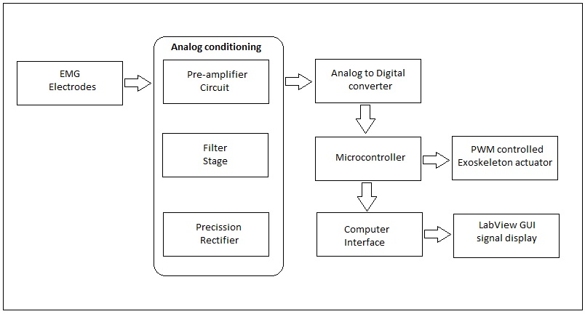
BLOCK DIAGRAM

Slide 14
SPECIFICATIONS
EMG Signal: 1-10 mV, 10-500 Hz (maximum energy in the 20-200Hz range).
Pre-Amplifier: Differential inamp using OPA4227(Gain=201)
Filters: 1. Low-pass filter (200Hz).
2. High-pass filter (10Hz).
3. Notch filter
Rectifier
ATmega32U4(in-built ADC)
Servo motor: 1.Torque15-19kgf.cm
2.Operating voltage: 4.8V-6V
3.Stall Current: 3.5A

Slide 15
SYSTEM DESIGN

Slide 16
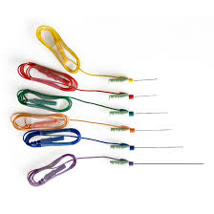
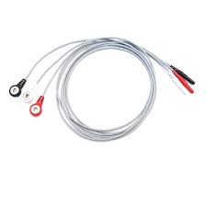
WHY SURFACE EMG?
Needle electrodes
Surface electrodes
Impractical and uncomfortable for a portable application
Need of medical supervision
Hence, not quite popular
No need of medical supervision due to its non-invasive nature
The crucial factors for sEMG are:
Skin preparation
Electrode placement

Slide 17
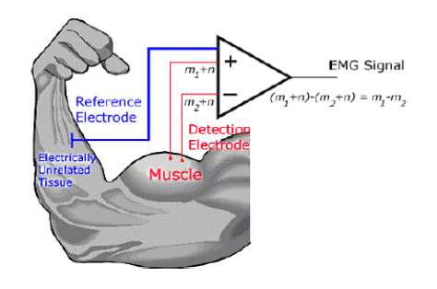
EXTRACTION
Based on the concept of differential amplification
As a result any signal which is “common” to both the detection sites will be removed and signals that are “different” at the two sites will be amplified

Slide 18
REQUIREMENTS OF INAMP
Low offset voltage(the offset must not dominate the signal)
Low Noise(external noise interferences must be very low)
High CMRR(reject the common mode signals and amplify only the differential signals)
High gain(to amplify signal from micro-volts to volts)

Slide 19
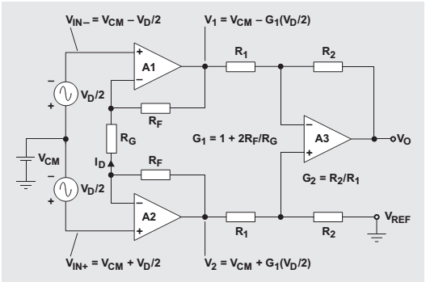
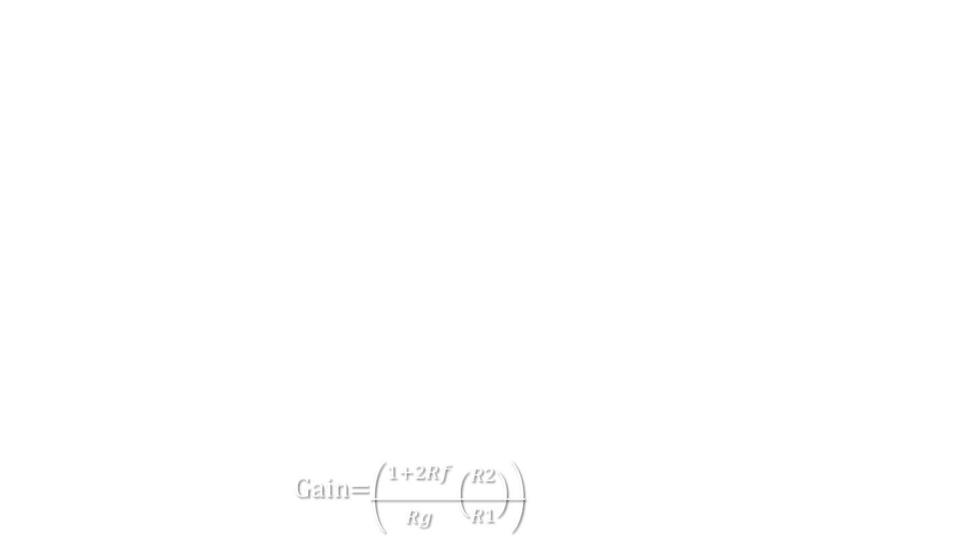

CIRCUIT DIAGRAM
Gain=$\left({1+2Rf \atop \begin{aligned} \\ Rg\end{aligned}}\left({R2 \atop \begin{aligned} \\ R1\end{aligned}}\right)\right)$
$\left(V2−V1\right)$

Slide 20
FILTERS
ISEK standards: dominant area of EMG is 10Hz-200Hz
Butterworth approximation used to have a flat response in the pass band
4th order filters used to get a high roll-off rate to get near ideal response
A twin-T notch filter used to eliminate supply noise

Slide 21

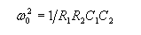
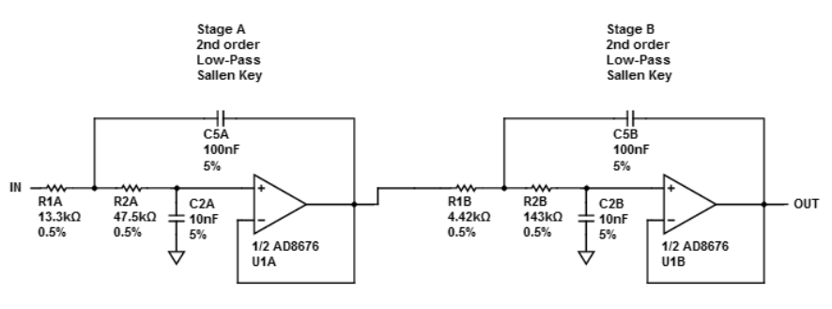
Low Pass Filter:1.Gain=1
2.Cutoff=200Hz

Slide 22
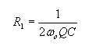
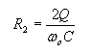
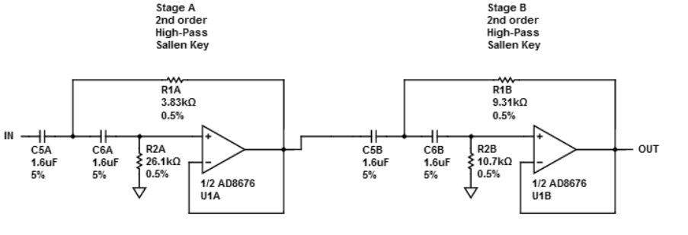
High Pass Filter:1.Gain=1
2.Cutoff=10Hz
Assuming C1=C2=C

Slide 23
RECTIFIER
EMG signal is in the order of a few milli volts
Precision rectifier used to curtail the voltage drop across diodes
Rectifier is build using AD8620

Slide 24
CONTROLLER
ATmega32U4 by Atmel (USB series).
No need of a separate programmer.
On-chip ADC (10bit resolution; Vref=2.56V).
12 channel ADC: Multiple inputs handled
PWM signal for the servo motor.
Serial Transmission for computer interface.

Slide 25
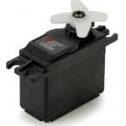
SERVO MOTOR
VS-11 servo by Vigor Precision is used.
High Torque Servo (15 to 19 kg-cm torque).
PWM signal decides the angle of rotation.
3 wire connection: power, ground, and control
Metal Gears and own drive electronics that draws the required current.

Slide 26
ALGORITHM
1. Start.
2. Initialize ADC, timer for PWM and USART settings.
3. Set a specified number of iterations (n) corresponding to a limited time interval.
4. Take ADC values continuously for the number of iterations (n).
5. Calculate the maximum ADC value which represents the peak EMG signal value in the time duration.
6. Compare the maximum ADC value with the threshold ranges and find out the PWM value to be set.
7. Set the output compare register (OCRn) to set the appropriate PWM value and hence the angle of the servo motor.
8. Send the collected ADC values through USART for the LabVIEW display.
9. Go to step 3.

Slide 27
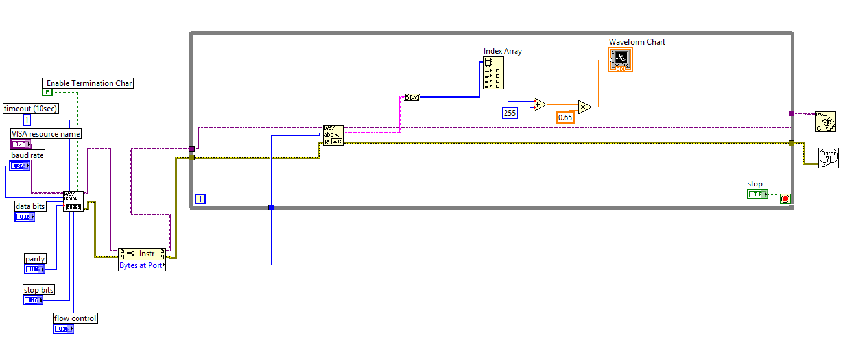
Labview : BLOCK Diagram

Slide 28
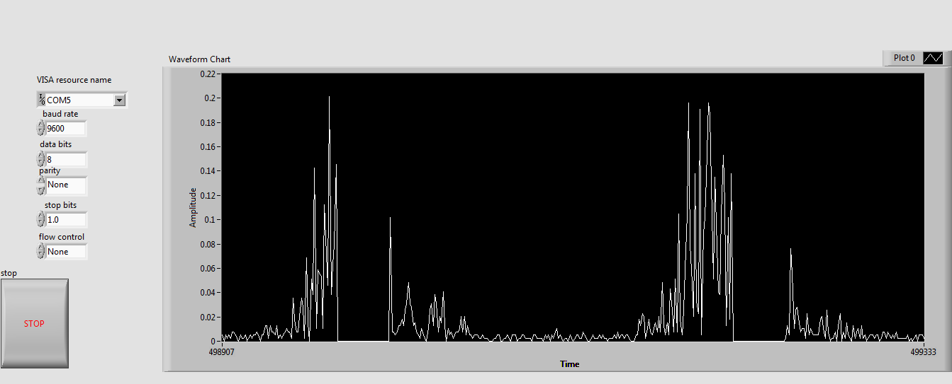
Labview :Control Panel

Slide 29
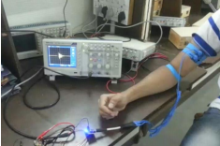
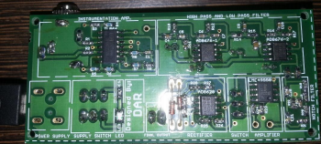
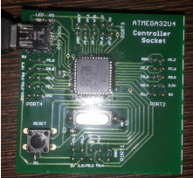
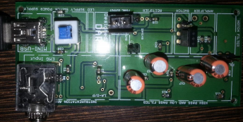
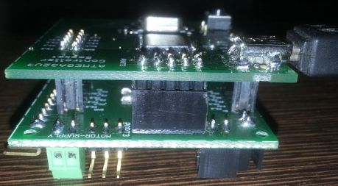
The System

Slide 30
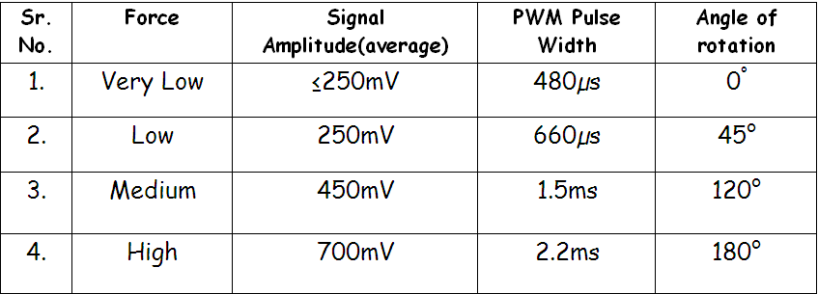
PERFORMANCE

Slide 31
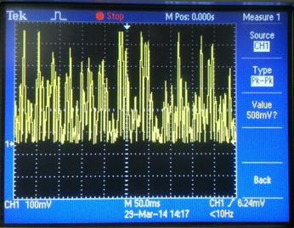
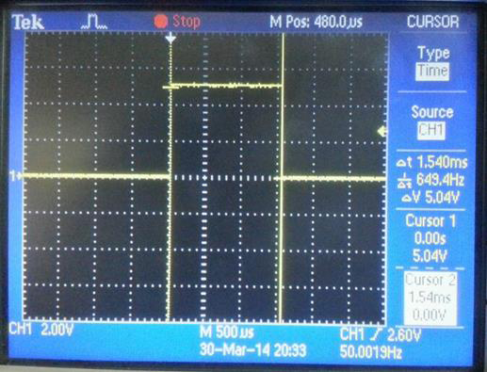
RESULTS

Slide 32
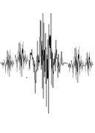
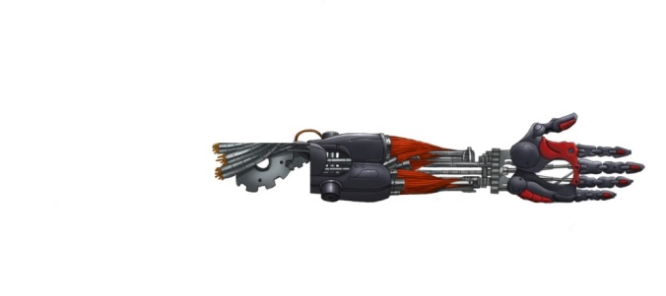

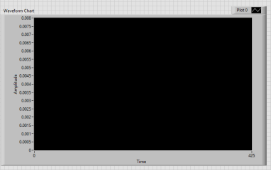
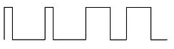
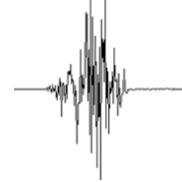
Analog Extraction
And
Conditioning Circuit.
Servo
PWM
Microcontroller
ADC

Slide 33
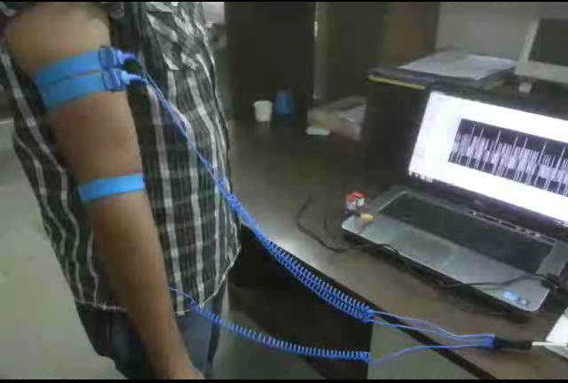
Working

Slide 34
APPLICATIONS

Slide 35
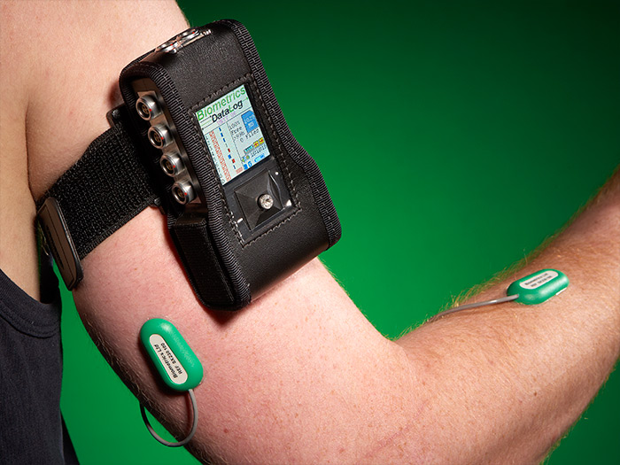
MEDICAL ANALYSIS AND RESEARCH
Study the disorders and abnormalities related
to muscle movement
Real time muscle activity analysis as well as stored portable analysis can be implemented

Slide 36
MUSCLE REHABILITATION
Provide support and muscle movement force for helping patients recovering from a muscle injury or any other muscle disorder.

Slide 37
SPORTS SCIENCE RESEARCH
Study various muscle activities related to any specific sport to procure an optimum muscle response

Slide 38
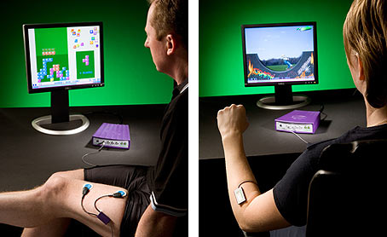
Computer human interface
Interface muscle activity to various computer applications such as games, moving a cursor, clicking icons and a lot more.

Slide 39
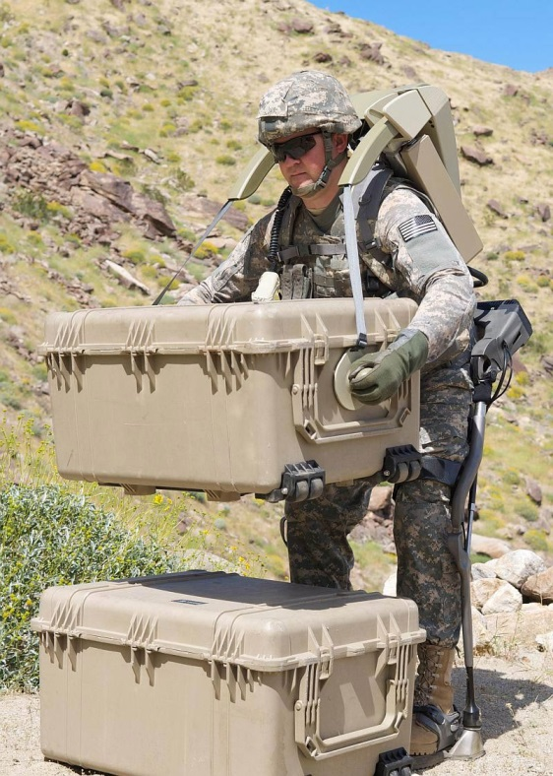
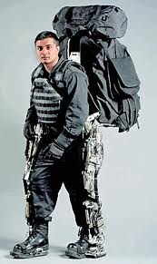
Ergonomic Support
By adding high power motors, high strength mechanical assembly and robust sensors ergonomic support skeletons can be developed which find use in industrial and military domain.

Slide 40
FUTURE SCOPE
The system can be expanded to cover entire body movement.
Nano motors can be incorporated as they are more compact
Can be made robust to assist the elderly and for ergonomic applications.
Precise and accurate active sensors can be used for total noise cancellation.
Help maintain proper muscle motion in case of hemiplegia.
Mobile application can be developed for ‘on the go’ monitoring of EMG.

Slide 41
REFERENCES
[1] ‘The ABC of EMG’, A practical introduction to Kinesiological Electromyography, Peter Konrad.
[2] ‘Techniques of EMG signal analysis: detection, processing, classification and Applications’, M. B. Reaz,1* M. S. Hussain1 and F. Mohd-Yasin1.
[3] ‘Surface Electromyography’ –Carlo J.De Luca, Delsys.
[4] ‘Important Factors in Surface EMG Measurement’- Dr. Scott Day, Bortec Biomedical.
[5] ‘A Myosignal -Based Powered Exoskeleton System’, IEEE Transactions on systems, MAN, and cybernetics—Part A: Systems and Humans, Vol. 31, No. 3, May 2001.
[6] Inter-electrode spacing of surface EMG sensors: Reduction of crosstalk, contamination during voluntary contractions- Carlo J.De Luca, Mikhail Kuznetsov , L.Donald Gilmore, Serge H. Roy.
[7]Standards for Reporting EMG Data: Dr. Roberto Merletti, Politecnico di Torino, Italy.
[8] Design of an Arm Exoskeleton Controlled by the EMG Signal-Mark Novak, Cornel College PHY312.
[9] Application of Surface Electromyographic Signals to Control Exoskeleton Robots -R. A.R. C. Gopura and Kazuo Kiguchi.

Slide 42
WEBSITES
[1] www.ti.com
[2] www.analog.com
[3] www.atmel.in
[4] www.e2e.ti.com
[5] www.avrfreaks.net
[6] www.ni.com/labview

Slide 43
THANK YOU

